Slide 1
Problems

Slide 2
Types of Computer
There are many different types of computer:
general purpose - PCs, Laptops etc
specialised - servers, routers,microcontrollers

Slide 3
Functions
In general computers can do four things:
Input (accepts data)
Processing (processes data)
Output (produces output)
Storage (save results)

Slide 4
Example
Using one specific computing device (i.e. your smart phone) give examples of these four functions in action:
Type of Computer: iPhone
Receives Messages
Take pictures
View the pictures
Save on cloud.

Slide 5
Why Computers?
What advantages/disadvantages are there when using a computer for a task, compared to a human?
(list as many reasons as you can)
Advantages
Generally removes human error.
Performs tasks quicker.
Documents can be remote.
You can make it do anything you want (within reason)
Disadvantages
Can lack human reasoning.
Only know how to do things as instructed by humans.
Expensive.
Difficult to learn.
Could break down.

Slide 6
List some Apps that are used for...
Storing of information
Gmail Drive
Cloud
Email
Dropbox

Slide 7
List some Apps that are used for...
Retrieving information
Safari
Wikipedia
Dictionary offline

Slide 8
List some Apps that are used for...
Sending or communicating information
Skype
Messenger
Email
Viber
Whatsapp
Kik

Slide 9
List some Apps that are used for...
Modifying or transforming information.
FTP
Picture Filter.

Slide 10
Hardware/Software
What is the difference between hardware and software?
Hardware is the physical components of a computer that can be seen and touched while software is the operating system that the computer uses to operate and tell the computer what to do

Slide 11
What are the following for?
CPU- the electronic part that carries out instructions
GPU- the circuitry that processes and produces images and visuals.
RAM- the internal memory within the computer that can accessed at any time.
Motherboard- allows the other parts of the computer to communicate with eachother.
Hard Drive- an information storage device

Slide 12
Software I
What is an operating system (OS) ? List some variants.
The part of the computer that puts the programmes in place and tells the computer what to do.
iOS
Windows

Slide 13
Software II
In relation to computer software, what are drivers?
Driver is the part of the software that connects the software to the hardware and allows it to work.

Slide 14
Networks
What do computer networks allow us to do?
allows computers to exchange data.
What is the difference between the world wide web (www) and the internet? Internet is a network of all the computers in the world and allows them to connect. WWW is a way of accessing information available on the Internet.

Slide 15
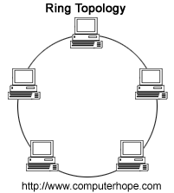
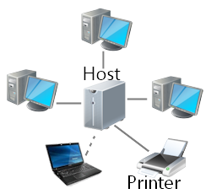
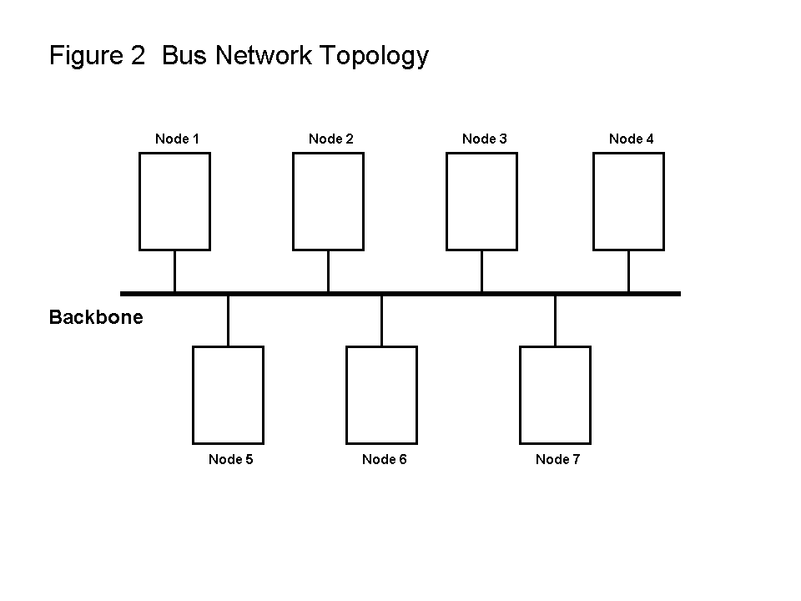
Network Topologies
What do the following network configurations look like?
Ring
Star
Bus
Which configuration do you think this lab uses?
Bus

Slide 16
Acronyms
Explain:
LAN- local area network.
WAN- Wide area network
MAN- Metropolitan area network

Slide 17
Protocols
A protocol is simply an agreed way of doing things. For instance, social protocol dictates that if someone greets you with “Dia duit” you reply with “Dia is Muire duit”
Computers have similar - albeit more robust - communication protocols.

Slide 18
What are these Protocols for?
SMTP/POP3- For the delivery and download of emails.
FTP- To transfer files from one host computer to another over the Internet.
TCP/IP- Networks (How computers web together)

